Slide 1
E SPORTS APPLICATION
DONE BY
K.SAIGOPAL

Slide 2
AIM:
To perform and identifying the positive and negative test case scenarios for login module and adding module for e sportsapplication.

Slide 3
TEST CASE SCENARIOS FOR LOGIN MODULE:
Verify the messages for each mandatory field.
Verify if the user cannot proceed without filling all the mandatory fields.
Verify the age of the user when the DOB is selected.
Verify if the numbers and special characters are not allowed in the First and Last name.
Verify if a user can sign-up successfully with all the mandatory details.
Verify if a user can log in with the valid details.
Verify if the Password and Confirm Password fields are accepting similar strings only.
Verify if the Password field will prompt you for the weak passwords.
Verify if duplicate email address will not get assigned.
Verify that hints are provided for each field on the form, for the ease of use.

Slide 4
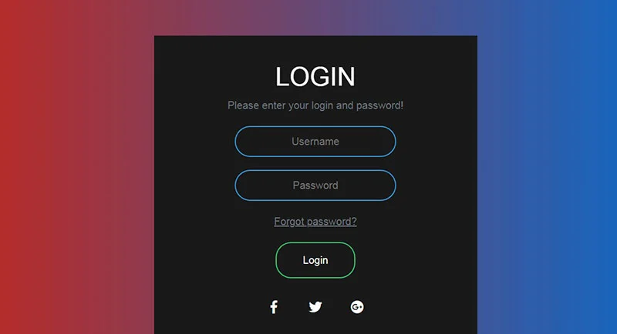

Slide 5
Verify if a user can log in with a valid username and password.
Verify if a user cannot log in with an invalid username or password. Check permutation and combinations of this.
Verify the ‘Keep me Sign In’ option. If this check box is selected, then the user should not get logged out even after exiting the app.
Verify if this check box is not selected by default.
If the user has signed up with Facebook or social media, verify that the user can log in with those credentials or not.
Verify the Forgot password functionality.
Verify if the login page fits the mobile screen. The user should not have to scroll the screen.

Slide 6
TEST SCENARIOS:
1 | Enter the valid email address & click next. Verify if the user gets an option to enter the password.
2 | Don’t enter an email address or phone number & just click the Next button. Verify if the user will get the correct message or if the blank field will get highlighted.
3 | Enter the invalid email address & click the Next button. Verify if the user will get the correct message.
4 | Enter an invalid phone number & click the Next button. Verify if the user will get the correct message.
5 | Verify if a user can log in with a valid email address and password.

Slide 7
TEST CASE SCENARIOS FOR ADDING MODULE:
Verify that the user added extra games or not.
Verify that the user added games.
Verify that the user not added the games.
Verify the added games are working properly or not.
Verify that the added games working properly.
Verify that the added games not working properly.
Verify that the developer developed payment mode to access the game.
Verify that the game has best features compared to the other games.

Slide 8
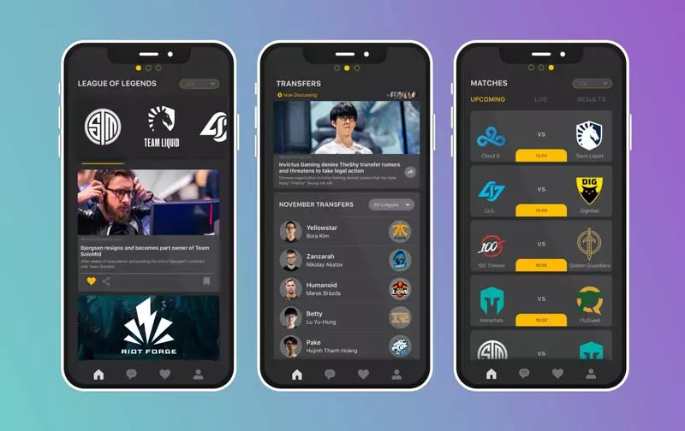

Slide 9
CONCLUSION:
While writing test cases for login or sign-up page write the test cases for all the fields. There should be a combination of both positive and negative test cases. Try to cover the performance, security, and functional scenarios.
The login page is the page with fewer controls, so even though it is looking simple for testing, it should not be considered as an easy task.
Also many a time it is the first impression of an application, so it should be perfect for user interface and usability.

